Slide 1
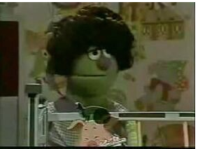
Robustly optimized BERT Pretraining Approaches
(RoBERTa)
전 창 욱
Notes:
Sesame Street(세서미 스트리트) roberta (로베르타)

Slide 2
Summary of changes in pretraining approaches used to enhance the performance of BERT model
state-of-the-art results in 4 out of 9 GLUE tasks.

Slide 3
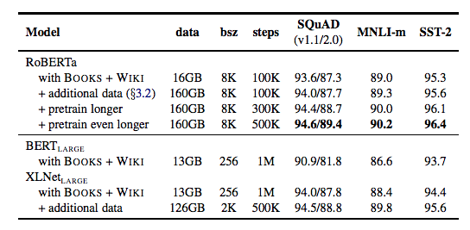
DATA
BERT(LARGE) 보다 Data 13GB → 160GB
BERT(LARGE) 보다 steps 1M 보다 뛰어나다
Notes:
CommonCraw News 76GB
OpenWebText, Reddit WebText 38GB
소설 스타일 데이터 31GB

Slide 4
Next Sentence Prediction Loss
BERT
MLM(Masked Language Model)
+
NSP (Next Sentence Prediction)
두가지 유형 교육 목표로 사용
MLM BERT
교체 토큰: 15 % 그 중 80%: [MASK] 10% : 변경 안함 10% : Random token

Slide 5
Next Sentence Prediction Loss
MLM NSP
[CLS] what is and isn ’ t affected by the government shut ##down [SEP] transportation security administration officers checking passengers at pittsburgh international airport last week . the agency ’ s employees have called out sick in increased numbers across the country since the shut ##down began .[SEP]
[CLS] what is and isn ’ t affected by the government shut ##down [SEP] gr ##udge ##s can be good . they are one habit that humans have evolved to keep ourselves from the pain of breakup ##s and also from eating mo ##zza ##rella sticks for every meal . [SEP]
Notes:
Next Sentence Prediction Loss
[CLS] what is and isn ’ t affected by the government shut ##down [SEP] transportation security administration officers checking passengers at pittsburgh international airport last week . the agency ’ s employees have called out sick in increased numbers across the country since the shut ##down began .[SEP]
[CLS] what is and isn ’ t affected by the government shut ##down [SEP] gr ##udge ##s can be good . they are one habit that humans have evolved to keep ourselves from the pain of breakup ##s and also from eating mo ##zza ##rella sticks for every meal . [SEP]

Slide 6
Next Sentence Prediction Loss
MLM NSP
이진 분류 작업
주어진 두 sequence의 relationship 와 context를 이해하고 downstream을 개선하도록 설계
NSP를 제거하면 NLU(National Language Understanding) 작업의 성능이 저하 (BERT)
XLNet, SpanBERT 등과 같은 최근 모델에서는 NSP손실의 필요성에 의문을 던짐

Slide 7
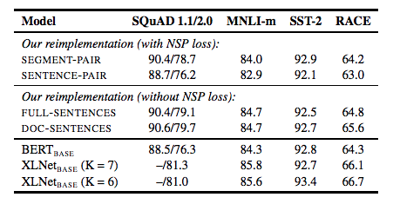
Next Sentence Prediction Loss
MLM NSP
DOC-SENTENCES 성능이 우수함
RoBERTa FULL-SENTENCES 설정 사용

Slide 8
Static vs Dynamic Masking
BERT == Static Masking
RoBERTa == Dynamic Masking
훈련 데이터 10회 복제
Epoch 마다 다른 Masking 된 훈련 데이터 만나게 함
Notes:
Static vs. Dynamic Masking

Slide 9
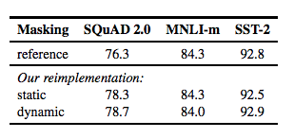
Static vs Dynamic Masking
RoBERTa 비슷하거나 우수
Notes:
Static vs. Dynamic Masking

Slide 10
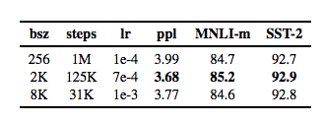
Training with large mini-batch
Large mini-batch MLM 난이도 상승
Efficiency can be improved by gradient
Notes:
Training with large mini-batch
efficiency can be improved by gradient accumulation.

Slide 11
Byte-Pair Encoding
일반적으로 10K – 100K
BERT heuristic token rule 30K
RoBERTa 50K (Radford Paper : Language Models are Unsupervised Multitask Learners)
https://www.techbooky.com/wp-content/uploads/2019/02/Better-Language-Models-and-Their-Implications.pdf
Notes:
Byte-Pair Encoding
heuristic

Slide 12

Conclusions
Small decision come to influence performance
RoBERTa model overfit after 500k steps
눈알 붙이기 엄청 고생 했음

Slide 13
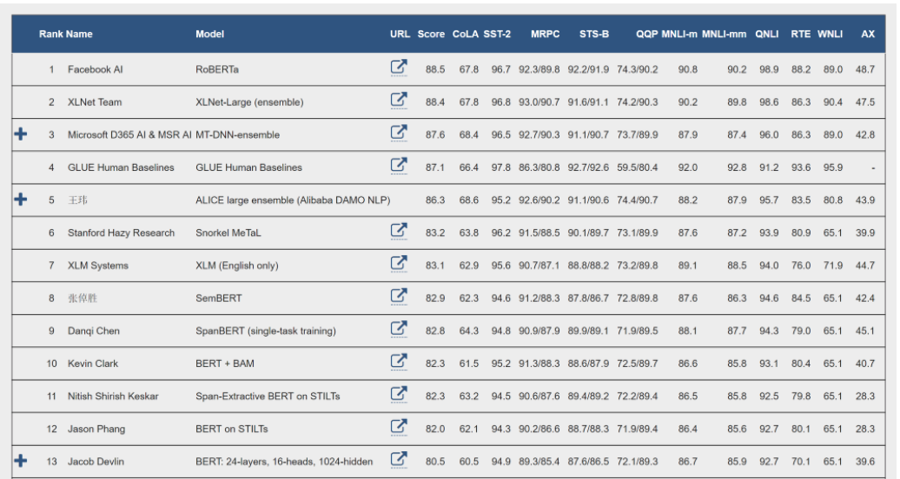
Notes:
Span bert 는 로베르타 이틀전에 출판

Slide 14
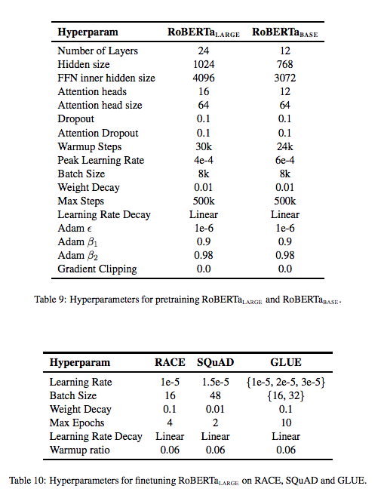
Notes:
RACE (Reading Comprehension Dataset)

Slide 15
감사합니다.

